Slide 1
Thank you for using MakeMyTrip's services on WhatsApp. Please answer these questions to help us serve you better.
Tuesday, January 09, 2018

Slide 2
208
Total Responses
Date Created: Friday, December 22, 2017
Complete Responses: 208

Slide 3
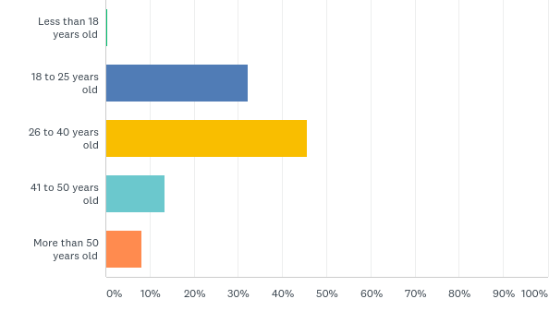
Q1: Your age...
Answered: 208 Skipped: 0

Slide 4
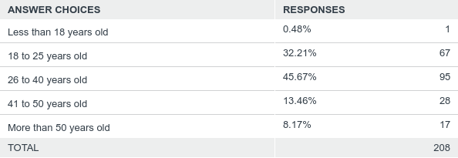
Q1: Your age...
Answered: 208 Skipped: 0

Slide 5
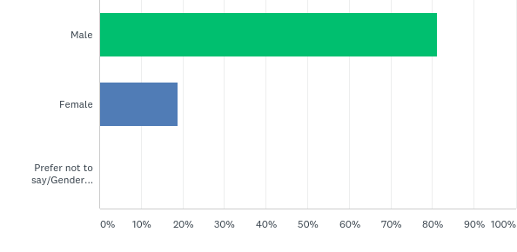
Q2: You are a...
Answered: 208 Skipped: 0

Slide 6
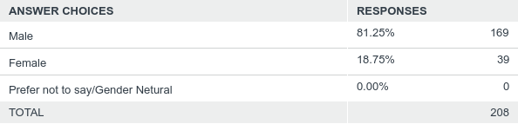
Q2: You are a...
Answered: 208 Skipped: 0

Slide 7
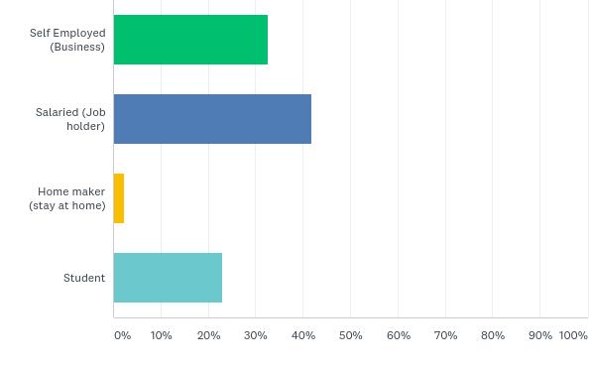
Q4: Your occupation
Answered: 208 Skipped: 0

Slide 8
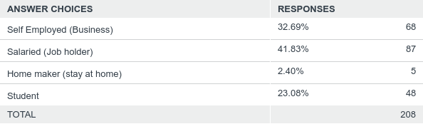
Q4: Your occupation
Answered: 208 Skipped: 0

Slide 9
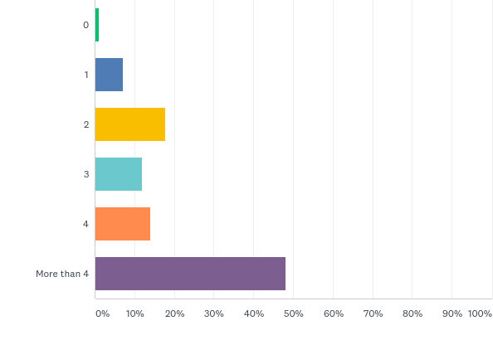
Q5: How many times do you travel in a year?
Answered: 208 Skipped: 0

Slide 10
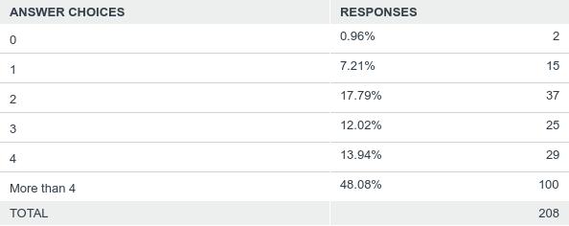
Q5: How many times do you travel in a year?
Answered: 208 Skipped: 0

Slide 11
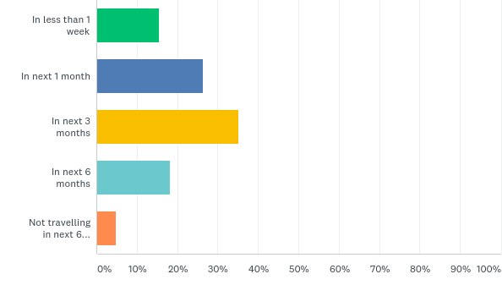
Q6: When do you plan to travel next?
Answered: 208 Skipped: 0

Slide 12
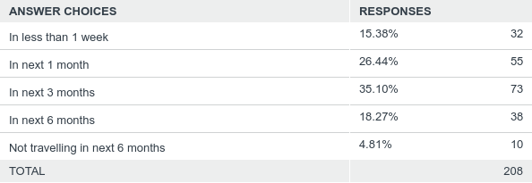
Q6: When do you plan to travel next?
Answered: 208 Skipped: 0

Slide 13
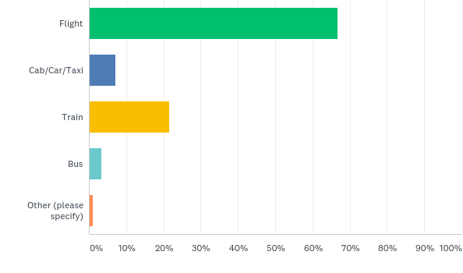
Q7: You mostly travel by...
Answered: 208 Skipped: 0

Slide 14
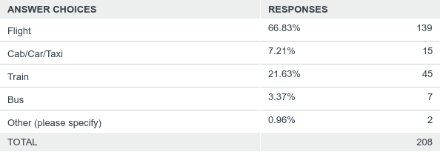
Q7: You mostly travel by...
Answered: 208 Skipped: 0

Slide 15
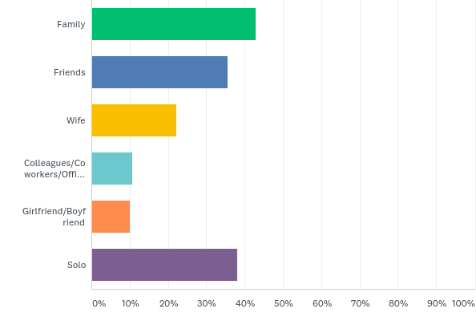
Q8: Whom do you normally travel with? (tick all that apply)
Answered: 208 Skipped: 0

Slide 16
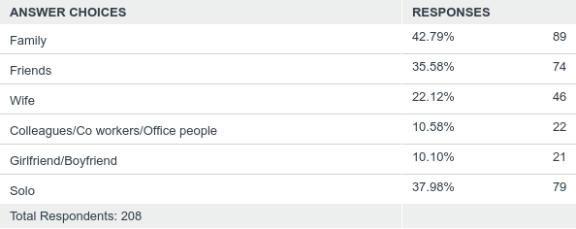
Q8: Whom do you normally travel with? (tick all that apply)
Answered: 208 Skipped: 0

Slide 17
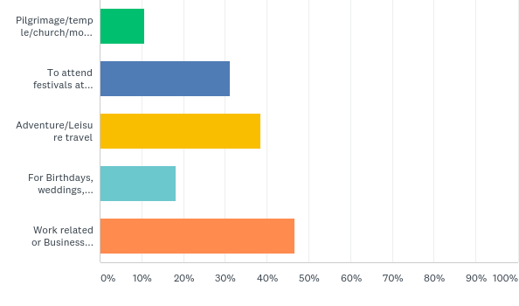
Q9: The most common reason for your travel/trip (tick all that apply)
Answered: 208 Skipped: 0

Slide 18
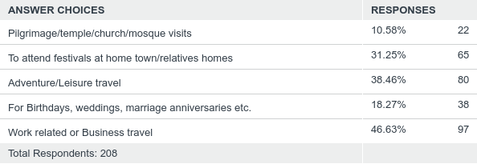
Q9: The most common reason for your travel/trip (tick all that apply)
Answered: 208 Skipped: 0

Slide 19
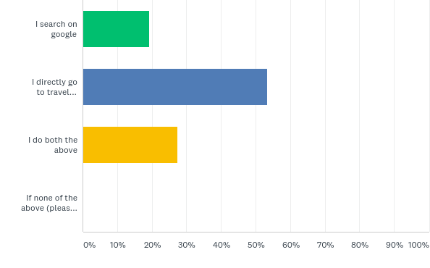
Q10: How do you search for travel related information online?
Answered: 208 Skipped: 0

Slide 20
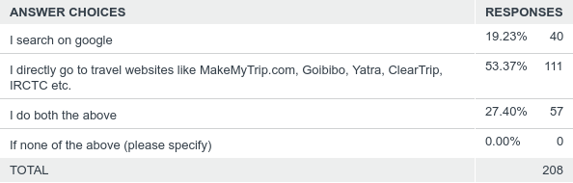
Q10: How do you search for travel related information online?
Answered: 208 Skipped: 0

Slide 21
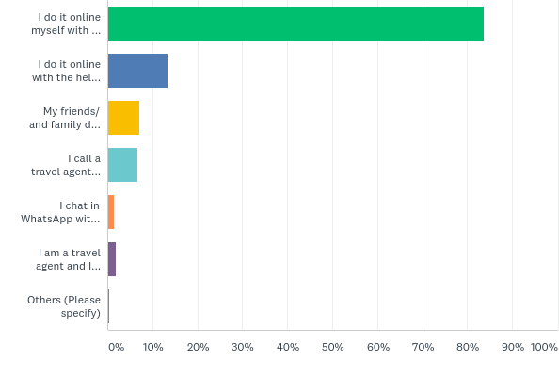
Q11: How do you book your travel tickets? (tick all that apply)
Answered: 208 Skipped: 0

Slide 22
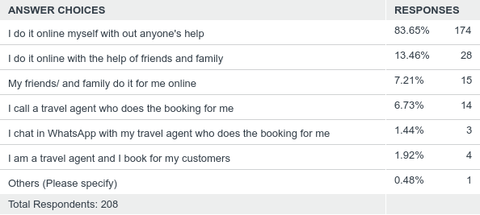
Q11: How do you book your travel tickets? (tick all that apply)
Answered: 208 Skipped: 0

Slide 23
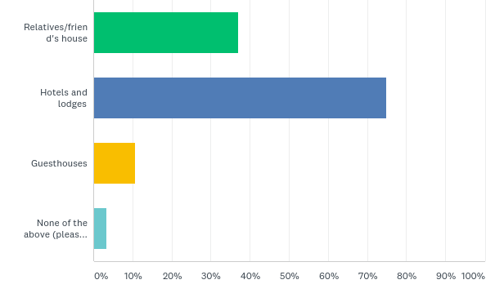
Q12: Where do you stay when you travel outside your city? (tick all that apply)
Answered: 208 Skipped: 0

Slide 24
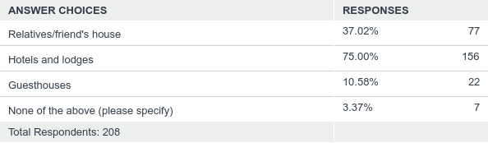
Q12: Where do you stay when you travel outside your city? (tick all that apply)
Answered: 208 Skipped: 0

Slide 25
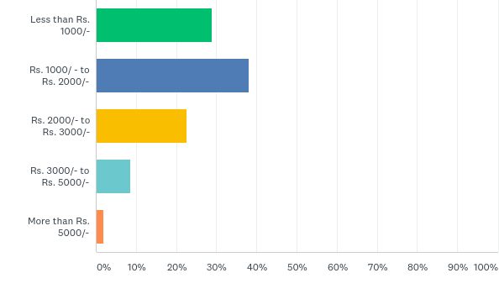
Q13: How much do you usually pay per day for a hotel room?
Answered: 208 Skipped: 0

Slide 26
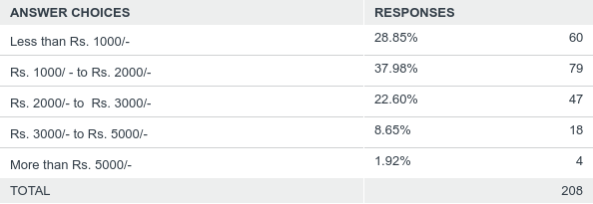
Q13: How much do you usually pay per day for a hotel room?
Answered: 208 Skipped: 0

Slide 27
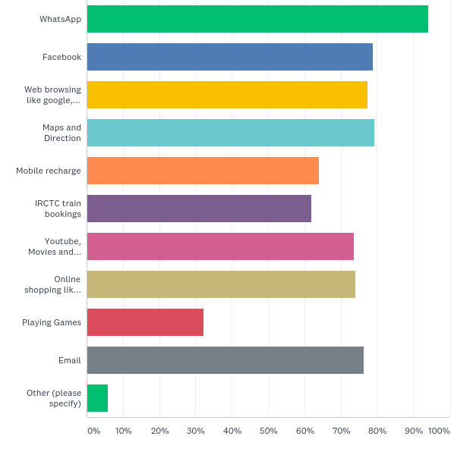
Q14: You use internet for.. (tick all that apply)
Answered: 208 Skipped: 0

Slide 28
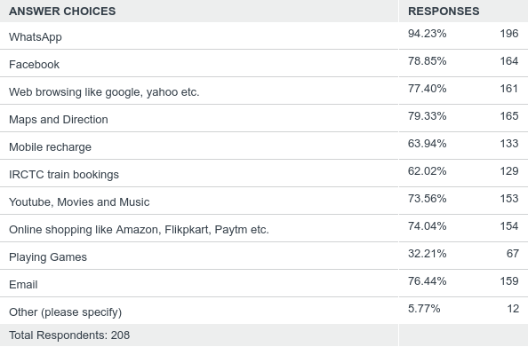
Q14: You use internet for.. (tick all that apply)
Answered: 208 Skipped: 0

Slide 29
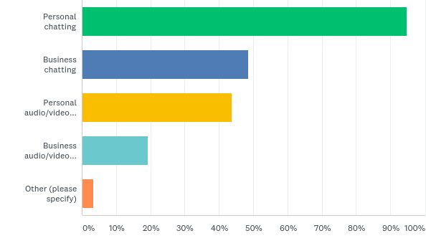
Q15: You use WhatsApp for.... (tick all that apply)
Answered: 208 Skipped: 0

Slide 30
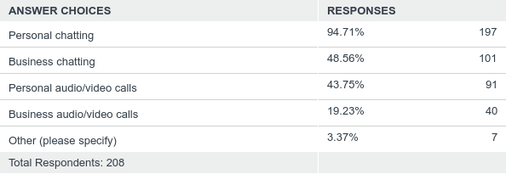
Q15: You use WhatsApp for.... (tick all that apply)
Answered: 208 Skipped: 0

Slide 31
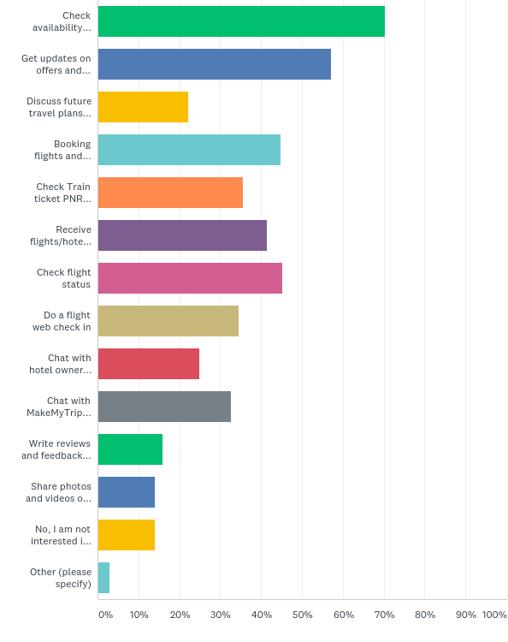
Q16: What would you like to do with MakeMyTrip via WhatsApp chat ? (tick all that apply)
Answered: 208 Skipped: 0

Slide 32
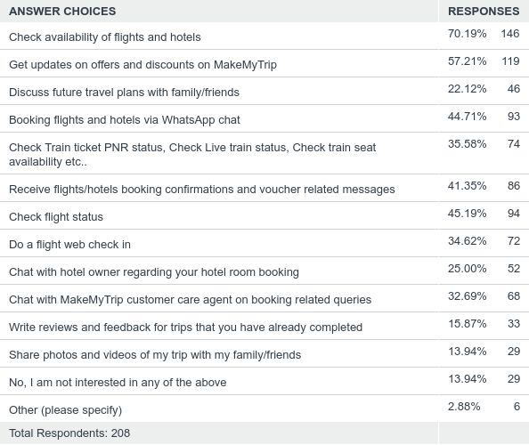
Q16: What would you like to do with MakeMyTrip via WhatsApp chat ? (tick all that apply)
Answered: 208 Skipped: 0

Slide 33
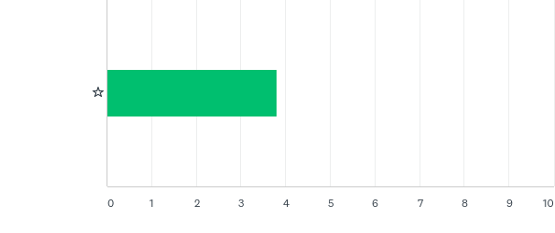
Q17: How do you rate MakeMyTrip's services on WhatsApp
Answered: 208 Skipped: 0

Slide 34

Q17: How do you rate MakeMyTrip's services on WhatsApp
Answered: 208 Skipped: 0

